Slide 1
Interoperability - vitrual

Slide 2
Do’s and don’ts
Goals
Showcase two ideas: service discovery and http(s) client/server model
Create a virtual environment to test scenarios and implementations
Showcase of a fully decentralized model - this does not require a central server nor a central database to discover different equipment or facilitate communication between equipment within the same network
What it isn’t
It does not constitute a proposal for the adoption of any technologies or communication standards
The code isn’t optimal nor stable

Slide 3
Service discovery
Multicast DNS vith DNS-SD
Networking protocol that resolves hostnames to IP addresses within small networks that do not include a local name server
A zero-configuration service, widely used, supported by all modern OS-s and IoT
Uses DNS PTR, SRV, TXT records to advertise instances of service types, domain names for those instances, and optional configuration parameters for connecting to those instances
Standardised in RFC 6762 and 6763

Slide 4
http(s) client/server model
Communication model that powers WEB
Supported on every device that connects to internet
Used in HL7 FHIR to ensure broader compatibillity and faster developement

Slide 5
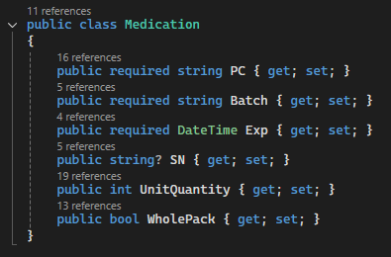
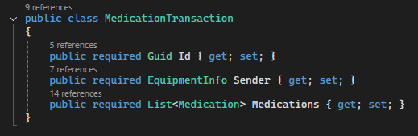
Data model
All transactions follow the same model:
Two HTTP endpoints – /inventory and /dispense
Support for single and multiple medication within the same stock or dispense requests
Source code available at: https://github.com/afriscic/InteroperabillityShowcase

